Slide 1
Financial Significance and Analysis of Counter: Strike 2 items
Zeyuan WANG
Jiawen WU

Slide 2
Introduction
Brief Introduction
Recent Transaction price of knife items
Analysis of the degree of price fluctuation: Quantify the data using EWMA, classify using SVM, and use the data of stable items category to represent the base level to predict the future market trend.
Conclusion: There are 61 items in the stable category among the all 200 items that were scraped. The knife market of CS2 will rise for few days then drop quickly.

Slide 3
Web Scraping
EWMA
Classifications by SVM
Regression and Forecast by ARIMA

Slide 4
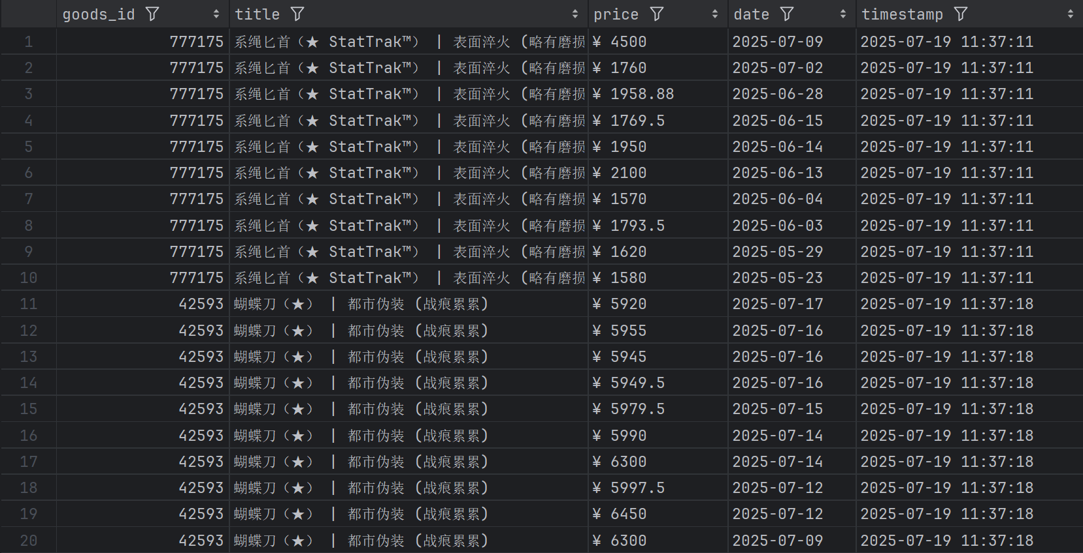
Web Scraping
Data Description
200 items
Latest 10 transaction data of all items
Time series data

Slide 5
Web Scraping
Conclusion
The information and prices of the accessories are loaded from the https://buff.163.com/api/market/goods? API interface and returned to the front-end page. It is impossible to obtain the data by simply parsing the front-end page. Switch to viewing other categories to check the pattern of the interface parameters.
The key parameters are: game=csgo (game type), page_num=1 (page number), category_group=knife (target category)

Slide 6

Web Scraping
CS2 Transaction Rrice Scraper
import time import random import pandas as pd import os from selenium import webdriver from selenium.webdriver.common.by import By from selenium.webdriver.chrome.options import Options from selenium.webdriver.chrome.service import Service from selenium.webdriver.support.ui import WebDriverWait from selenium.webdriver.support import expected_conditions as EC from selenium.common.exceptions import TimeoutException, NoSuchElementException, WebDriverException from bs4 import BeautifulSoup import json from tqdm import tqdm import sys # Configuration Parameters BASE_URL = "https://buff.163.com" MARKET_URL = "https://buff.163.com/market/csgo" CATEGORY_GROUP = "knife" # 匕首分类 MAX_PAGES = 10 MAX_PRODUCTS = 2000

Slide 7
Web Scraping
CS2 Transaction Rrice Scraper
# Chrome Driver CHROME_DRIVER_PATH = r"C:\Work\ChromeDriver\chromedriver-win64\chromedriver.exe" USER_AGENT = "Mozilla/5.0 (Windows NT 10.0; Win64; x64) AppleWebKit/537.36 (KHTML, like Gecko) Chrome/125.0.0.0 Safari/537.36" def create_browser(): print("正在初始化浏览器...") chrome_options = Options() # Add optimization parameters chrome_options.add_argument(f"user-agent={USER_AGENT}") chrome_options.add_argument("--disable-blink-features=AutomationControlled") chrome_options.add_experimental_option("excludeSwitches", ["enable-automation"]) chrome_options.add_experimental_option('useAutomationExtension', False) chrome_options.add_argument("--disable-infobars") chrome_options.add_argument("--disable-dev-shm-usage") chrome_options.add_argument("--no-sandbox") chrome_options.add_argument("--disable-gpu") chrome_options.add_argument("--log-level=3") chrome_options.add_argument("--start-maximized") try: service = Service(executable_path=CHROME_DRIVER_PATH) browser = webdriver.Chrome(service=service, options=chrome_options)
import time import random import pandas as pd import os from selenium import webdriver from selenium.webdriver.common.by import Byfrom selenium.webdriver.chrome.options import Options from selenium.webdriver.chrome.service import Service from selenium.webdriver.support.ui import WebDriverWait from selenium.webdriver.support import expected_conditions as EC from selenium.common.exceptions import TimeoutException, NoSuchElementException, WebDriverException from bs4 import BeautifulSoup import json from tqdm import tqdm import sys # Configuration Parameters BASE_URL = "https://buff.163.com" MARKET_URL = "https://buff.163.com/market/csgo" CATEGORY_GROUP = "knife" # 匕首分类 MAX_PAGES = 10 MAX_PRODUCTS = 2000

Slide 8
Web Scraping
CS2 Transaction Rrice Scraper
def simple_login(browser): if not browser: print("浏览器未初始化") return False print("正在导航至登录页面...") browser.get(f"https://buff.163.com/account/login?back_url=/market/csgo") print("尝试填写登录表单...") try: time.sleep(3) print("等待登录完成...") time.sleep(5) if "market" in browser.current_url: print("登录成功！已重定向到市场页面") return True if browser.find_elements(By.CLASS_NAME, "verify-box"): print("检测到验证码，请手动完成验证") input("完成验证后按回车键继续...") return True print("登录状态不确定，继续尝试访问市场页面...") return True except Exception as e: print(f"登录过程中出错: {e}") return False

Slide 9
Web Scraping
CS2 Transaction Rrice Scraper
import time import random import pandas as pd import os from selenium import webdriver from selenium.webdriver.common.by import By from selenium.webdriver.chrome.options import Options from selenium.webdriver.chrome.service import Service from selenium.webdriver.support.ui import WebDriverWait from selenium.webdriver.support import expected_conditions as EC from selenium.common.exceptions import TimeoutException, NoSuchElementException, WebDriverException from bs4 import BeautifulSoup import json from tqdm import tqdm import sys # Configuration Parameters BASE_URL = "https://buff.163.com" MARKET_URL = "https://buff.163.com/market/csgo" CATEGORY_GROUP = "knife" # 匕首分类 MAX_PAGES = 10 MAX_PRODUCTS = 2000

Slide 10
Web Scraping
CS2 Transaction Rrice Scraper: the rest of code.
def get_product_list(browser): if not browser: return [] products = [] # 遍历每一页 for page_num in range(1, MAX_PAGES + 1): print(f"正在处理第 {page_num} 页...") # 构建带页码的URL page_url = f"{MARKET_URL}#game=csgo&page_num={page_num}&category_group={CATEGORY_GROUP}&tab=top-bookmarked" print(f"导航到: {page_url}") browser.get(page_url) # 等待商品加载 time.sleep(3) # 解析商品列表 html = browser.page_source soup = BeautifulSoup(html, 'html.parser') # 查找所有商品项 items = soup.select('a[href^="/goods/"]') if not items: print("未找到商品，可能页面结构已更改") break print(f"找到 {len(items)} 个商品") # 修改商品列表提取部分 for item in items: try: href = item['href'] title = item.get('title', '') or ( item.select_one('.detail .name') and item.select_one('.detail .name').get_text( strip=True)) or "" # 提取商品ID goods_id = href.split('/')[-1].split('?')[0].split('#')[0] if goods_id and title: # 构建干净的URL base_goods_url = f"{BASE_URL}/goods/{goods_id}" goods_url = base_goods_url # 商品页面 history_url = base_goods_url + "#tab=history" # 历史价格页面 products.append({ 'goods_id': goods_id, 'title': title.strip(), 'url': goods_url, 'history_url': history_url }) print(f"添加商品: {title[:30]} (ID: {goods_id})") except Exception as e: print(f"解析商品时出错: {e}") # 如果达到最大商品数则停止 if len(products) >= MAX_PRODUCTS: print(f"已达到最大商品数限制 ({MAX_PRODUCTS})") break print(f"共找到 {len(products)} 个商品") return products[:MAX_PRODUCTS] # 获取商品价格历史 def get_price_history(browser, product): if not browser: return [] print(f"正在获取商品 {product['goods_id']} 的价格历史...") browser.get(product['history_url']) print("当前历史价格页面:", browser.current_url) # 等待历史价格加载 time.sleep(3) # 解析历史价格数据 html = browser.page_source soup = BeautifulSoup(html, 'html.parser') # 查找历史价格表格 history_table = soup.find('div', class_='detail-tab-cont') if not history_table: print(f"未找到商品 {product['goods_id']} 的历史价格表格") return [] # 提取价格数据 history = [] rows = history_table.select('tbody tr') if not rows: print("未找到历史价格行") return [] print(f"找到 {len(rows)} 条历史价格记录") for row in rows: try: date_elem = row.select_one('td:nth-child(6)') price_elem = row.select_one('td:nth-child(4) strong') or row.select_one('td:nth-child(4)') if date_elem and price_elem: date = date_elem.get_text(strip=True) price = price_elem.get_text(strip=True) history.append({'date': date, 'price': price}) print(f"添加价格记录: {date} - {price}") except Exception as e: print(f"解析价格行时出错: {e}") return history # 处理单个商品 def process_product(browser, product): if not browser: return product try: # 获取历史价格 price_history = get_price_history(browser, product) # 添加历史价格到商品数据 product['price_history'] = price_history # 添加统计信息 if price_history: try: prices = [] for item in price_history: try: price_str = item['price'].replace('¥', '').replace(',', '').strip() if price_str: # 确保不是空字符串 prices.append(float(price_str)) except ValueError: print(f"无法转换价格: {item['price']}") if prices: product['history_min'] = min(prices) product['history_max'] = max(prices) product['history_avg'] = sum(prices) / len(prices) product['history_points'] = len(prices) else: product['history_min'] = None product['history_max'] = None product['history_avg'] = None product['history_points'] = 0 except Exception as e: print(f"计算价格统计信息时出错: {e}") product['history_min'] = None product['history_max'] = None product['history_avg'] = None product['history_points'] = 0 else: product['history_min'] = None product['history_max'] = None product['history_avg'] = None product['history_points'] = 0 # 添加时间戳 product['timestamp'] = time.strftime('%Y-%m-%d %H:%M:%S') # 随机延迟 sleep_time = random.uniform(2.0, 5.0) print(f"等待 {sleep_time:.1f} 秒后继续...") time.sleep(sleep_time) return product except Exception as e: print(f"处理商品 {product['goods_id']} 时出错: {e}") return product # 主函数 def main(): print("启动网易BUFF饰品历史价格爬虫...") # 创建浏览器实例 browser = create_browser() if not browser: print("无法创建浏览器实例，程序退出") return try: # 简化登录 print("=" * 50) print("正在尝试登录...") login_success = simple_login(browser) if not login_success: print("尝试直接访问市场页面...") browser.get(MARKET_URL) print("=" * 50) print("开始获取商品列表...") # 获取商品列表 products = get_product_list(browser) if not products: print("没有找到商品，程序退出") return print(f"开始处理 {len(products)} 个商品的历史价格...") # 处理每个商品的历史价格 processed_products = [] # 使用tqdm显示进度条 for i, product in enumerate(tqdm(products, desc="处理商品", file=sys.stdout)): processed = process_product(browser, product) processed_products.append(processed) # 每处理1个商品保存一次数据 save_to_json(processed_products, 'data/temp_products.json') print(f"已保存临时数据: data/temp_products.json") # 每处理5个商品保存一次完整数据 if (i + 1) % 5 == 0: save_to_excel(processed_products, 'data/temp_products.xlsx') save_history_to_csv(processed_products, 'data/temp_history.csv') # 保存最终结果 save_to_json(processed_products, 'data/buff_products_full.json') save_to_excel(processed_products, 'data/buff_products_summary.xlsx') save_history_to_csv(processed_products, 'data/buff_price_history.csv') print(f"爬取完成！共处理 {len(processed_products)} 个商品") except Exception as e: print(f"程序运行出错: {e}") finally: # 关闭浏览器 if browser: print("正在关闭浏览器...") browser.quit() print("浏览器已关闭") # 保存函数 def save_to_json(data, filename): try: os.makedirs(os.path.dirname(filename), exist_ok=True) with open(filename, 'w', encoding='utf-8') as f: json.dump(data, f, ensure_ascii=False, indent=2) print(f"数据已保存到 {filename}") return True except Exception as e: print(f"保存JSON文件时出错: {e}") return False def save_to_excel(data, filename): try: # 创建简化数据结构 simplified_data = [] for item in data: simplified = { 'goods_id': item['goods_id'], 'title': item['title'], 'history_min': item.get('history_min', ''), 'history_max': item.get('history_max', ''), 'history_avg': item.get('history_avg', ''), 'history_points': item.get('history_points', 0), 'url': item['url'], 'history_url': item['history_url'], 'timestamp': item.get('timestamp', '') } simplified_data.append(simplified) df = pd.DataFrame(simplified_data) os.makedirs(os.path.dirname(filename), exist_ok=True) df.to_excel(filename, index=False) print(f"数据已保存到 {filename}") return True except Exception as e: print(f"保存Excel文件时出错: {e}") return False def save_history_to_csv(data, filename): try: all_history = [] seen_records = set() # 用于记录已处理的记录 for product in data: if not product.get('price_history'): continue for history in product['price_history']: # 创建唯一标识符 (商品ID + 日期 + 价格) record_id = f"{product['goods_id']}-{history['date']}-{history['price']}" # 检查是否已处理过 if record_id in seen_records: continue seen_records.add(record_id) history_record = { 'goods_id': product['goods_id'], 'title': product['title'], 'price': history['price'], 'date': history['date'], 'timestamp': product.get('timestamp', '') } all_history.append(history_record) if not all_history: print("没有历史价格数据可保存") return False df = pd.DataFrame(all_history) os.makedirs(os.path.dirname(filename), exist_ok=True) df.to_csv(filename, index=False) print(f"历史价格数据已保存到 {filename}") return True except Exception as e: print(f"保存CSV文件时出错: {e}") return False if __name__ == "__main__": # 确保data目录存在 os.makedirs('data', exist_ok=True) # 运行主函数 main()

Slide 11
EWMA
EWMA Result
112 items are quantified by EWMA
Preparing for the SVM classification

Slide 12
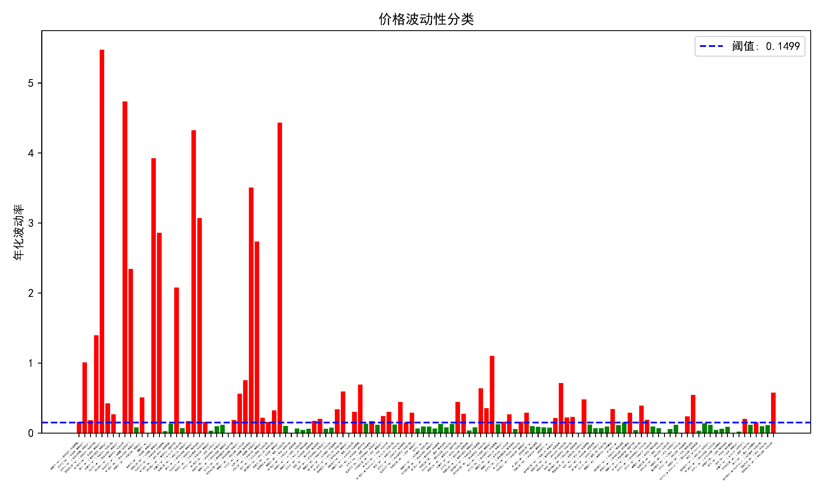
EWMA
EWMA Result

Slide 13
EWMA
EWMA Code
import pandas as pd import numpy as np import re # 1. 价格清洗函数 def clean_price(price_str): # 处理空值 if pd.isna(price_str) or price_str in ['', 'NaN', 'nan', 'None']: return np.nan # 移除货币符号、逗号、空格等非数字字符 cleaned = re.sub(r'[^\d.]', '', str(price_str)) # 处理空字符串 if cleaned == '': return np.nan # 转换数值并验证有效性 try: value = float(cleaned) # 验证价格合理性 if value <= 0 or value > 1000000: # 假设合理价格范围 return np.nan return value except ValueError: return np.nan # 2. 读取数据 df = pd.read_csv(r'C:\Work\DEDA\pythonProject\Buff\data\buff_price_history.csv', usecols=[1, 2, 3], header=None, skiprows=1, names=['series_name', 'price', 'trade_date']) # 3. 应用价格清洗 df['price'] = df['price'].apply(clean_price) # 4. 检查清洗结果 invalid_prices = df[df['price'].isna()] if not invalid_prices.empty: print(f"警告: {len(invalid_prices)} 行价格清洗失败") print("样本无效数据:") print(invalid_prices.head(3)) # 5. 处理同一天多价格记录 daily_stats = df.groupby(['series_name', 'trade_date'], sort=False).agg( daily_high=('price', 'max'), daily_low=('price', 'min'), daily_range=('price', lambda x: x.max() - x.min()) ).reset_index()

Slide 14
EWMA
EWMA Code
def validate_data(group): """验证数据完整性""" # 检查有效价格数量 valid_prices = group['price'].notna().sum() if valid_prices < 2: # 至少需要2个有效价格计算范围 return None # 计算每日指标 daily_high = group['price'].max() daily_low = group['price'].min() # 验证价格范围合理性 if daily_high <= daily_low: return None return pd.Series({ 'daily_high': daily_high, 'daily_low': daily_low, 'daily_range': daily_high - daily_low }) # 应用验证 daily_stats = df.groupby(['series_name', 'trade_date'], sort=False).apply(validate_data).reset_index() daily_stats = daily_stats.dropna() # 移除无效数据 # 6. 按Xn分组 xn_groups = daily_stats.groupby('series_name', sort=False) # 7. EWMA波动率计算 lambda_ = 0.94 volatility_results = {} feature_data = [] # 存储特征数据 for name, group in xn_groups: # 直接使用原始降序数据 log_range = np.log(group['daily_high'] / group['daily_low']) # 反向EWMA计算 variance = pd.Series(np.zeros(len(log_range)), index=group.index) # 从最新日期向最旧日期计算 for t in range(len(log_range) - 2, -1, -1): variance.iloc[t] = lambda_ * variance.iloc[t + 1] + (1 - lambda_) * log_range.iloc[t] ** 2 # 年化波动率 annual_vol = np.sqrt(variance.mean() * 252) volatility_results[name] = annual_vol vol_df = pd.DataFrame.from_dict(volatility_results, orient='index', columns=['volatility']) threshold = vol_df['volatility'].median() vol_df['category'] = np.where(vol_df['volatility'] > threshold, '变化剧烈', '变化稳定') print(vol_df)

Slide 15
EWMA
EWMA Code
# 可视化波动性分布 import matplotlib.pyplot as plt import matplotlib matplotlib.use('TkAgg') plt.rcParams['font.sans-serif'] = ['SimHei'] # 使用黑体 plt.rcParams['axes.unicode_minus'] = False # 解决负号显示问题 plt.figure(figsize=(10, 6)) colors = vol_df['category'].map({'变化剧烈': 'red', '变化稳定': 'green'}) plt.bar(vol_df.index, vol_df['volatility'], color=colors) plt.axhline(threshold, color='blue', linestyle='--', label=f'阈值: {threshold:.4f}') plt.title('价格波动性分类') plt.ylabel('年化波动率') plt.xticks(rotation=45, ha="right",size=2) plt.legend() plt.tight_layout() plt.savefig('volatility_classification.png', dpi=3000) # 获取所有变化稳定的系列名称 stable_series = vol_df[vol_df['category'] == '变化稳定'].index.tolist() # 从原始数据中提取这些系列的所有数据 stable_data = df[df['series_name'].isin(stable_series)] # 或者从每日统计数据中提取（根据后续分析需要选择其一） # stable_data = daily_stats[daily_stats['series_name'].isin(stable_series)] # 检查结果 print(f"变化稳定的系列数量: {len(stable_series)}") print(f"变化稳定的数据行数: {len(stable_data)}") print("\n变化稳定的系列列表:") print(stable_series) # 保存结果到新表格 stable_data.to_csv('stable_time_series1.csv', index=False) print(f"提取到 {len(stable_data)} 条稳定序列数据")

Slide 16
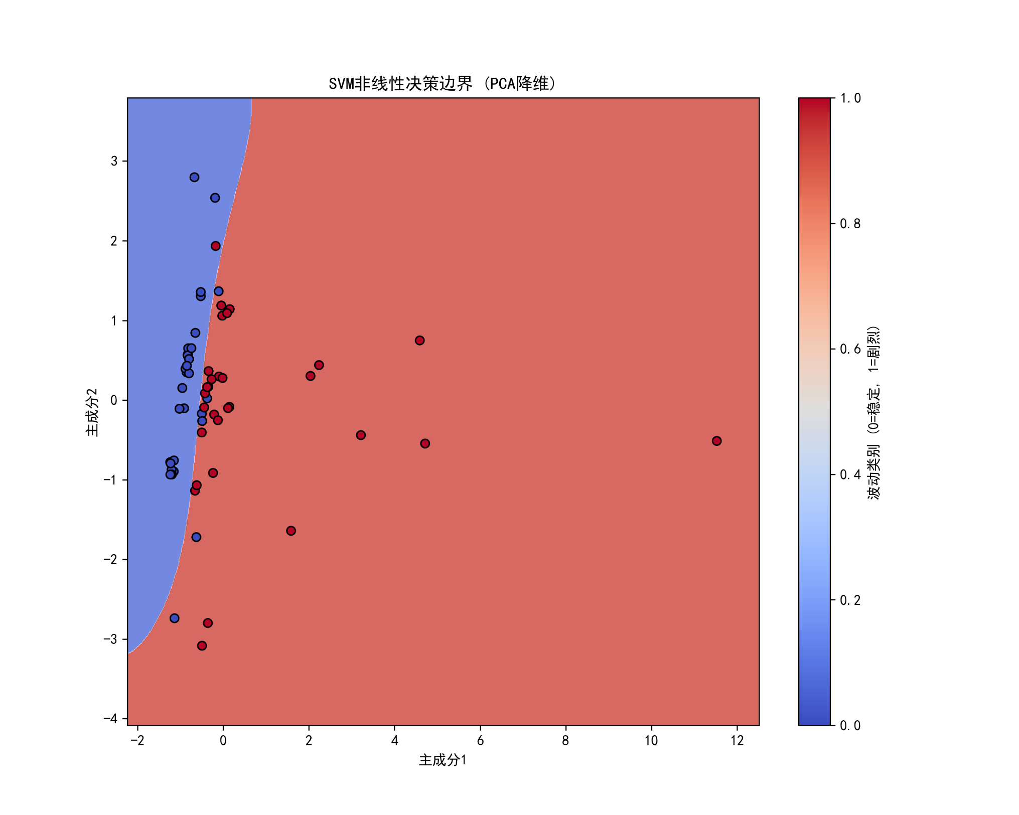
Classifications by SVM
Classification Results

Slide 17
Classifications by SVM
SVM Classification Conclusion
There are 61 items in the stable category
among the all 200 items that were scraped.

Slide 18
Regression and Forecast by ARIMA
ARIMA Introduction
We use the 61 stable items to represent the base level of the knife item market.
Integrate the data to show features of market.
Forecast the trend of market with the given data.

Slide 19
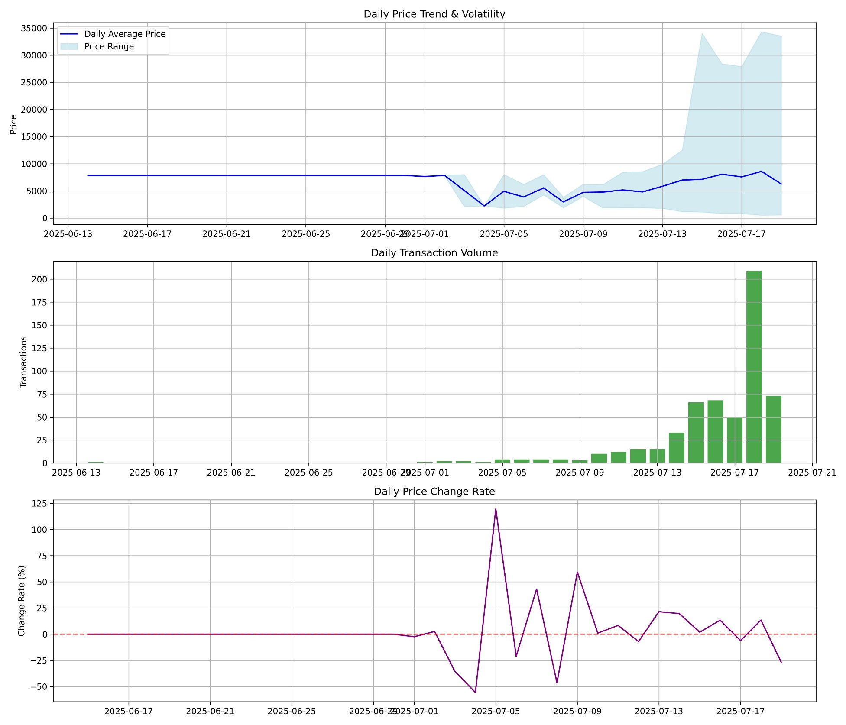
Regression and Forecast by ARIMA
Price Trend Analysis

Slide 20
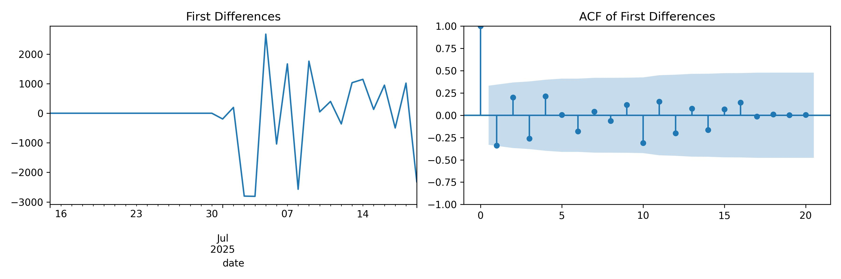
Regression and Forecast by ARIMA
Differencing Analysis

Slide 21
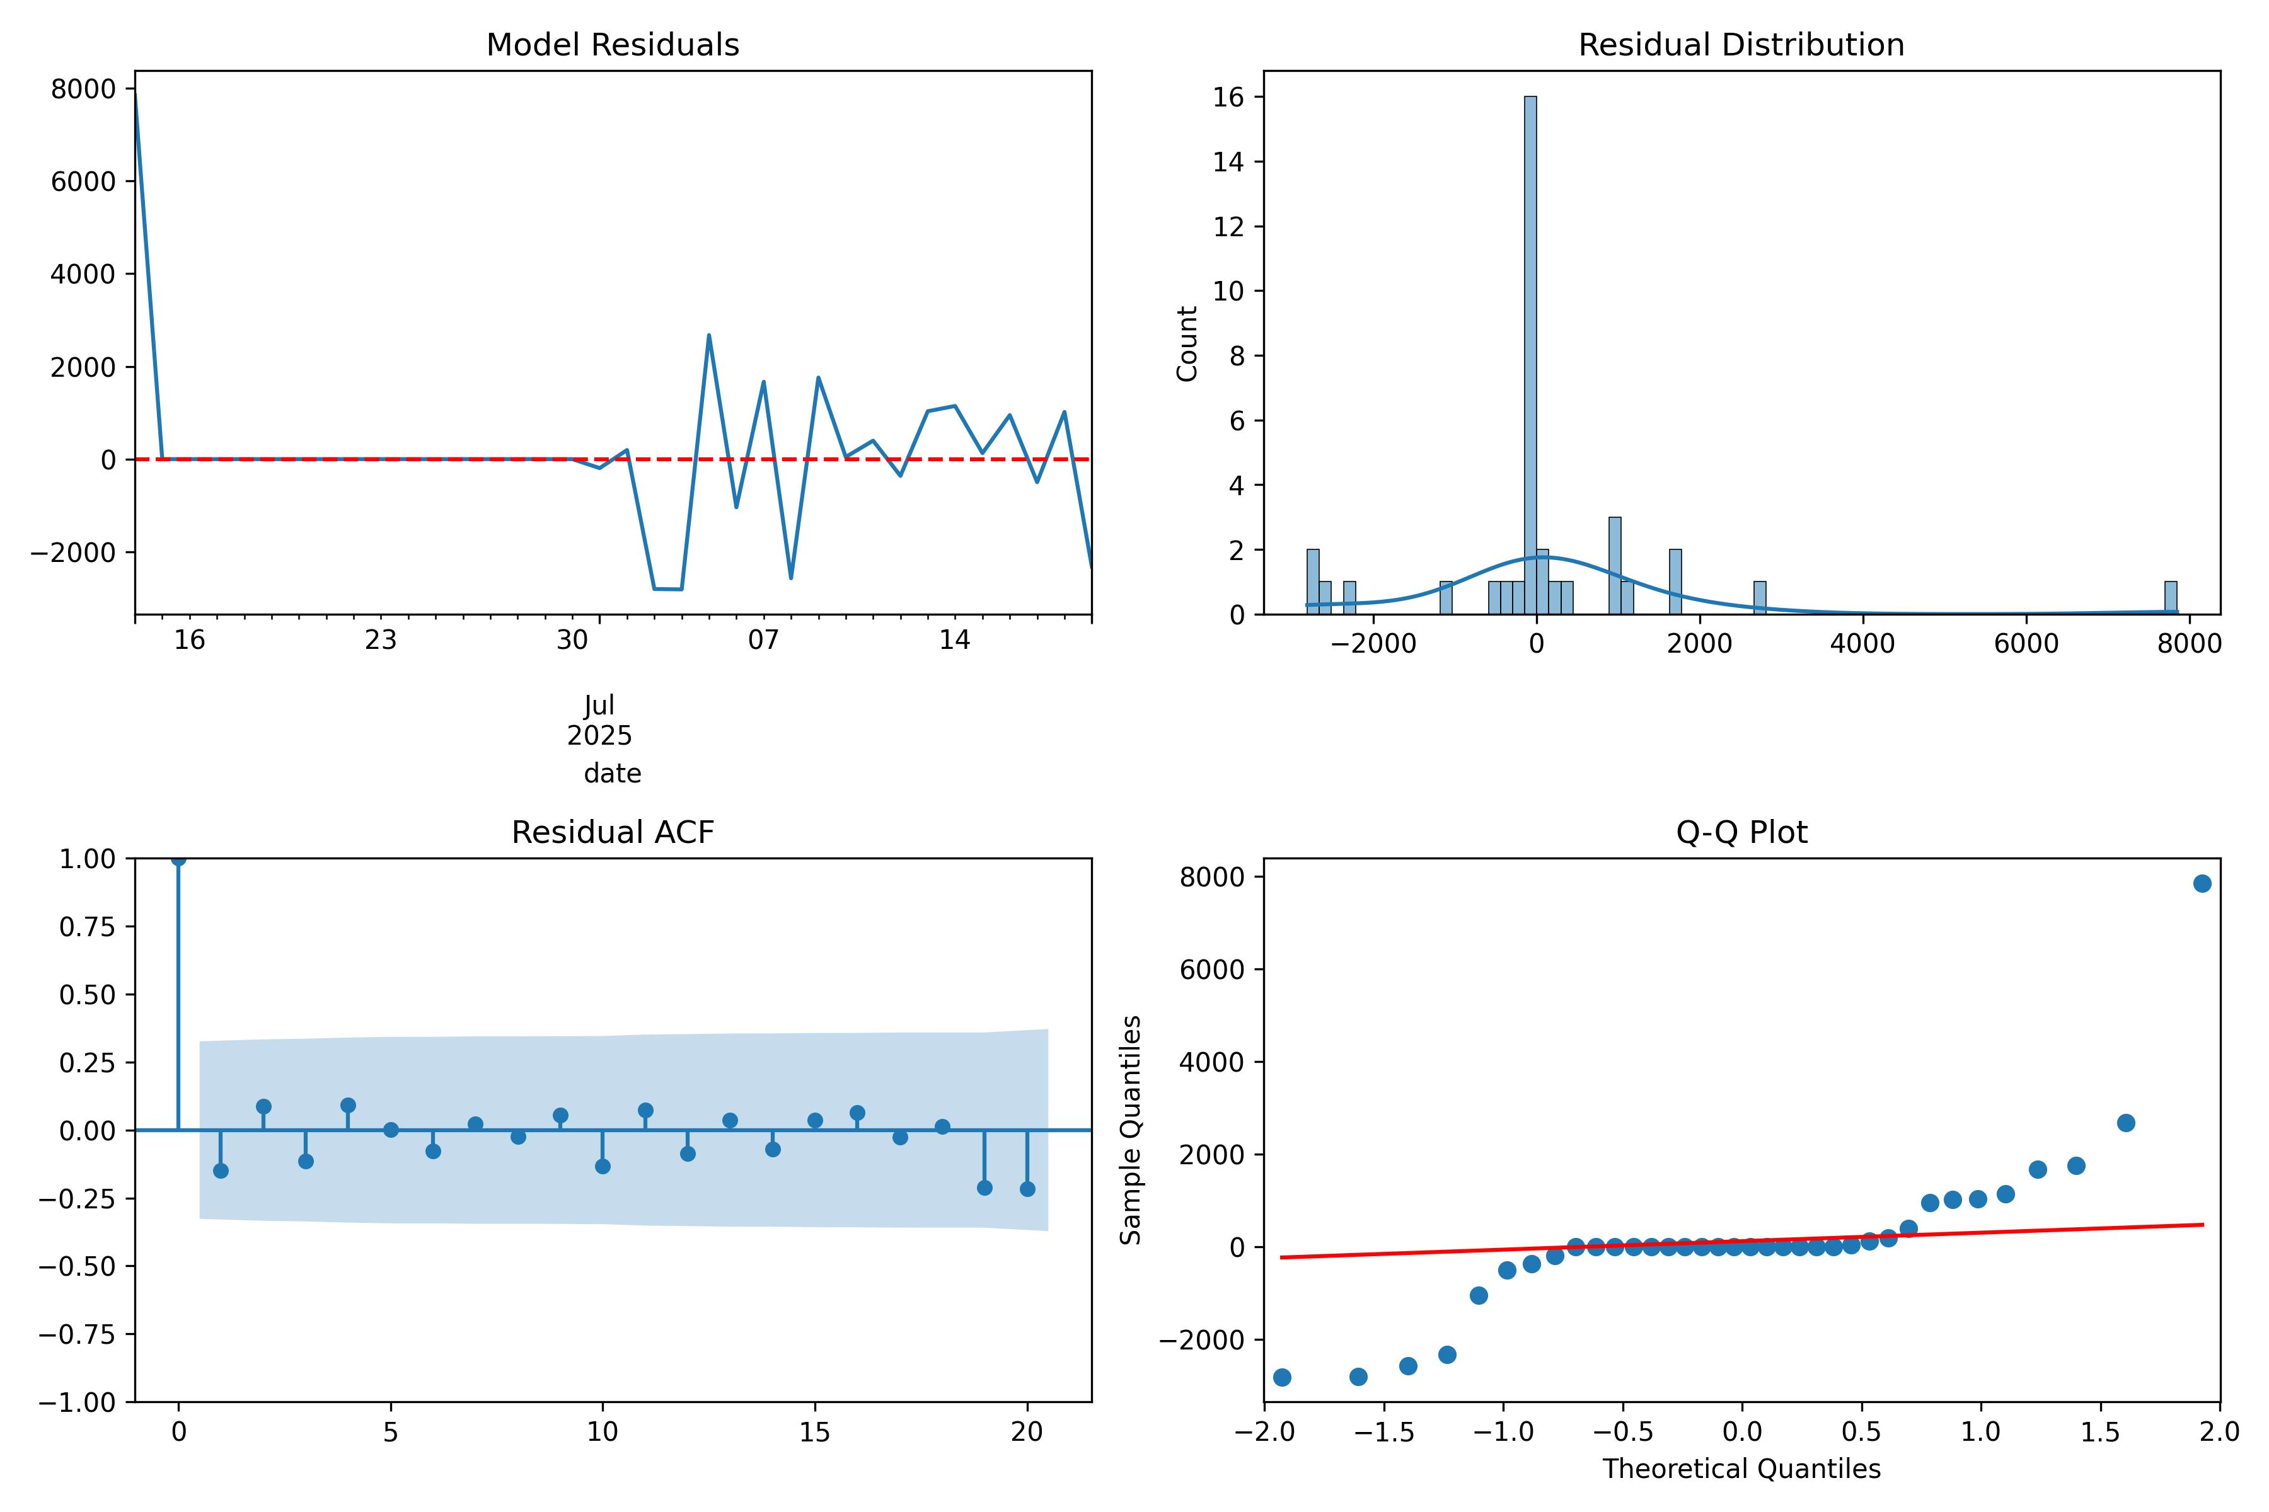
Regression and Forecast by ARIMA
Residual Diagnostics

Slide 22
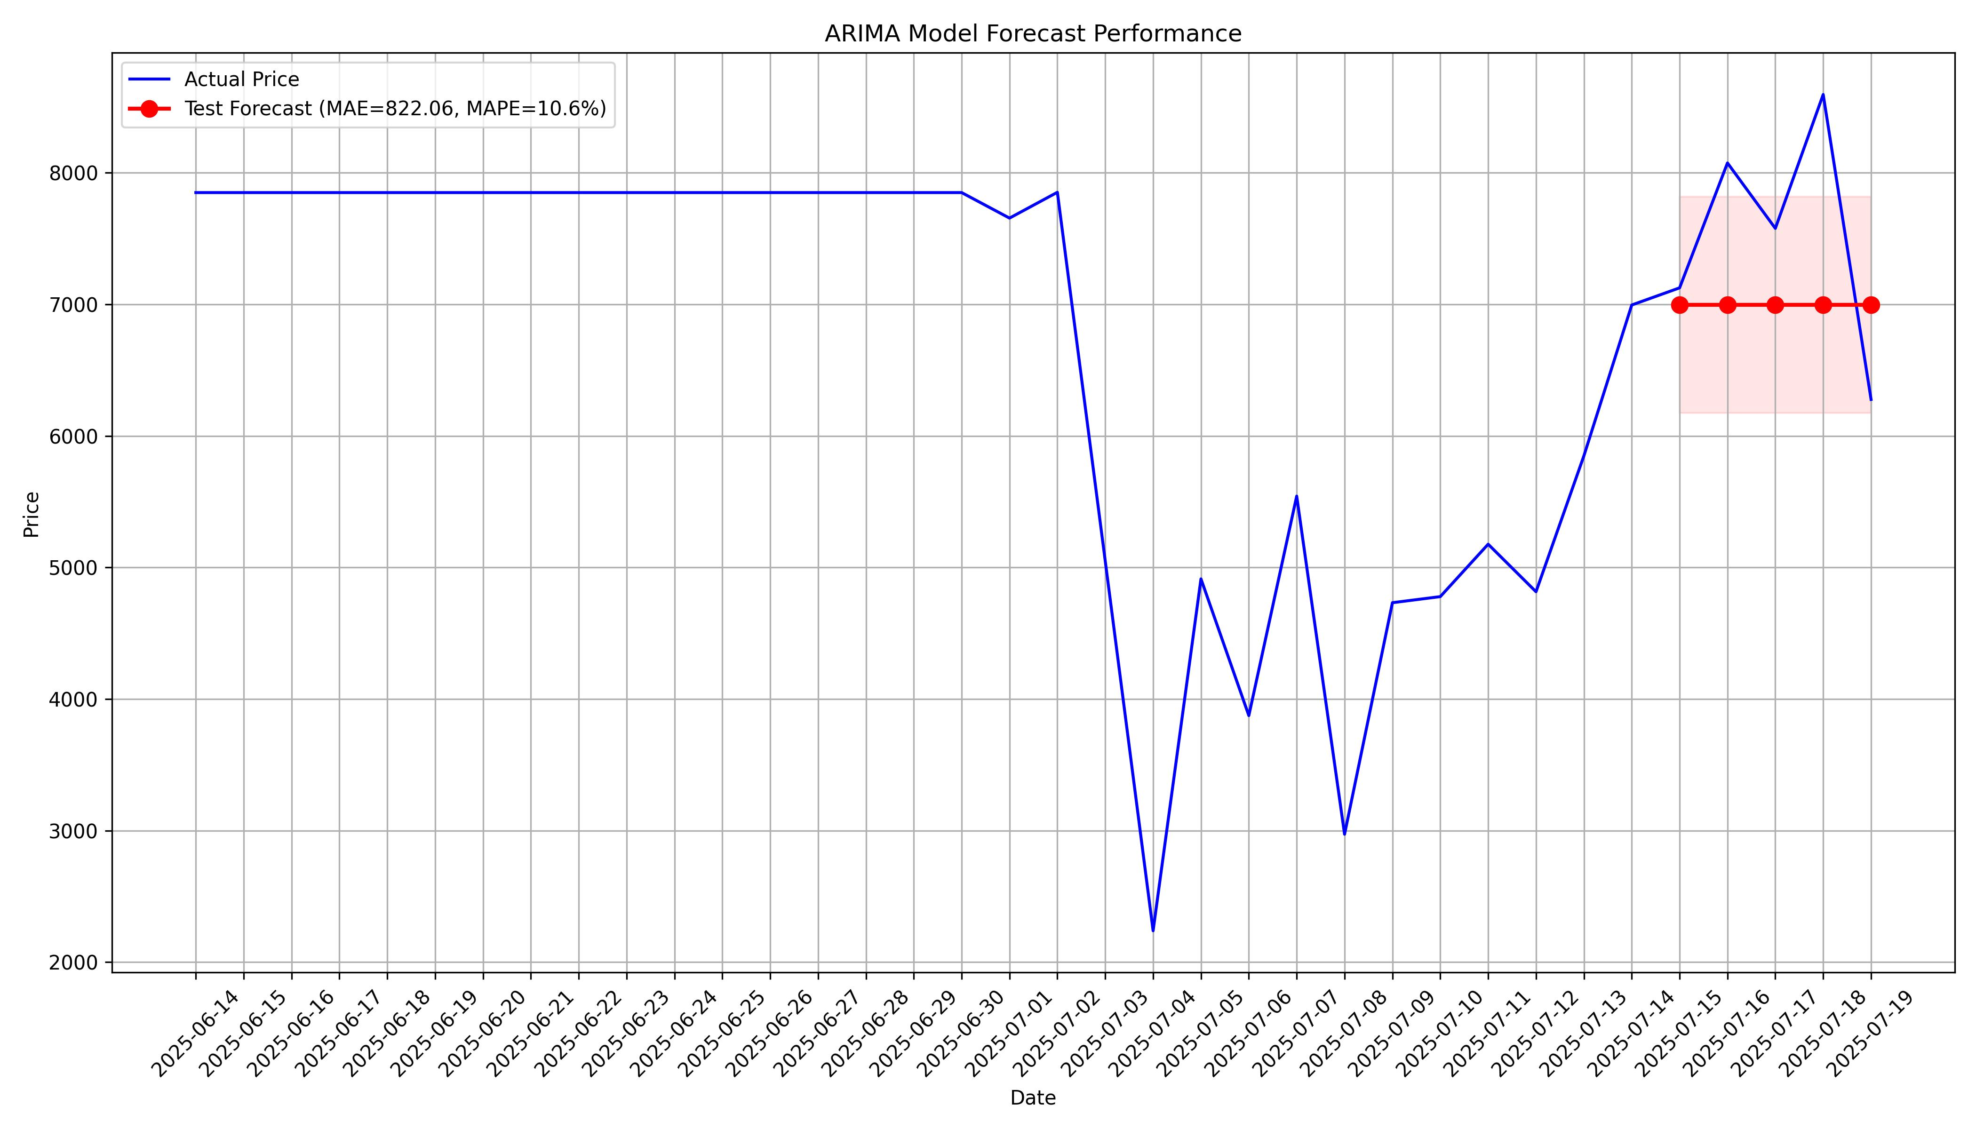
Regression and Forecast by ARIMA
Forecast Performance

Slide 23
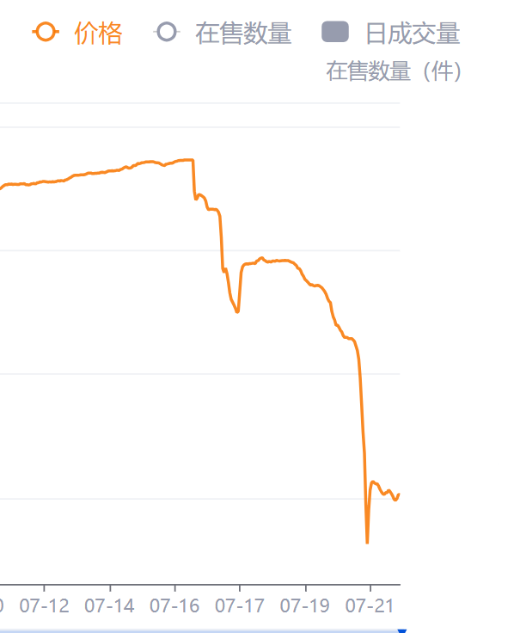
Regression and Forecast by ARIMA
Conclusion
Market sentiment is unstable. In the short term, the overall price will generally rise first and then fall.
The actual situation within a few days after the data analysis: Our conclusion was found to be partially correct.

Slide 24
Regression and Forecast by ARIMA
ARIMA Code
import pandas as pd import numpy as np import matplotlib.pyplot as plt import seaborn as sns from statsmodels.tsa.arima.model import ARIMA from pmdarima import auto_arima from statsmodels.tsa.stattools import adfuller from sklearn.metrics import mean_absolute_error, mean_absolute_percentage_error from statsmodels.graphics.tsaplots import plot_acf, plot_pacf import matplotlib.dates as mdates import matplotlib matplotlib.use('TkAgg') # 1. Load data file_path = "stable_time_series.csv" df = pd.read_csv(file_path, encoding='UTF-8', parse_dates=['trade_date']) # 2. Data preprocessing df.sort_values('trade_date', inplace=True) # Sort ascending (oldest first) # Calculate daily statistics daily_stats = df.groupby('trade_date')['price'].agg( ['count', 'min', 'max', 'mean', 'median', 'std'] ).reset_index() # Rename columns daily_stats.columns = ['date', 'transaction_count', 'daily_min', 'daily_max', 'daily_mean', 'daily_median', 'daily_std'] # 3. Ensure date continuity full_dates = pd.date_range(start=daily_stats['date'].min(), end=daily_stats['date'].max(), freq='D') full_df = pd.DataFrame({'date': full_dates}) # Merge data, fill missing values ts = full_df.merge(daily_stats, on='date', how='left') ts['transaction_count'] = ts['transaction_count'].fillna(0) def is_constant(series): return series.nunique() == 1 # 只填充非恒定序列 for col in ['daily_min', 'daily_max', 'daily_mean', 'daily_median', 'daily_std']: if not is_constant(ts[col]): ts[col] = ts[col].fillna(method='ffill') else: # 如果序列是常数，使用前向填充但跳过ADF检验 ts[col] = ts[col].fillna(method='ffill') print(f"Warning: Column {col} is constant after filling") ts.set_index('date', inplace=True) # 4. Data visualization plt.figure(figsize=(14, 12)) # Price trend plt.subplot(3, 1, 1) plt.plot(ts.index, ts.daily_mean, label='Daily Average Price', color='blue') plt.fill_between(ts.index, ts.daily_min, ts.daily_max, color='lightblue', alpha=0.5, label='Price Range') plt.title('Daily Price Trend & Volatility') plt.ylabel('Price') plt.legend() plt.grid(True) # Transaction volume plt.subplot(3, 1, 2) plt.bar(ts.index, ts.transaction_count, color='green', alpha=0.7) plt.title('Daily Transaction Volume') plt.ylabel('Transactions') plt.grid(True) # Price change rate plt.subplot(3, 1, 3) daily_returns = ts.daily_mean.pct_change().dropna() * 100 plt.plot(ts.index[1:], daily_returns, color='purple') plt.axhline(y=0, color='red', linestyle='--', alpha=0.5) plt.title('Daily Price Change Rate') plt.ylabel('Change Rate (%)') plt.grid(True) plt.tight_layout() plt.savefig('price_trend_analysis.jpg', dpi=300) plt.show() # 5. ARIMA modeling - using average price target = ts['daily_mean'].copy() def safe_adf_test(series, title=''): if series.nunique() == 1: print(f"Warning: Series '{title}' is constant. Cannot perform ADF test.") return 1.0 # 返回大于0.05的值强制差分 result = adfuller(series.dropna(), autolag='AIC') output = { 'ADF Test Statistic': result[0], 'p-value': result[1], '# of Lags': result[2], 'Critical Values': result[4] } print(f'ADF Test for {title}') for key, value in output.items(): print(f' {key}: {value}') return result[1] print("\nStationarity Test - Original Series:") p_value_original = safe_adf_test(target, 'Original Series') # Differentiation if p_value_original > 0.05: print("\nSeries is non-stationary - applying differencing...") diff_target = target.diff().dropna() print("\nStationarity Test - First Differences:") p_value_diff = safe_adf_test(diff_target, 'First Differences') # Visualize differentiation fig, axes = plt.subplots(1, 2, figsize=(12, 4)) diff_target.plot(ax=axes[0], title='First Differences') plot_acf(diff_target, ax=axes[1], lags=20, title='ACF of First Differences') plt.tight_layout() plt.savefig('differencing_analysis.jpg', dpi=300) plt.show() d = 1 # Differencing order else: print("\nSeries is stationary - no differencing needed") diff_target = target d = 0 # 6. Auto-ARIMA parameter search print("\nSearching for optimal ARIMA parameters...") try: auto_model = auto_arima( target, start_p=0, start_q=0, max_p=3, max_q=3, d=d, seasonal=False, trace=True, error_action='ignore', suppress_warnings=True, stepwise=True ) # Get best parameters best_order = auto_model.order print(f"\nOptimal ARIMA parameters (p,d,q): {best_order}") except Exception as e: print(f"Auto-ARIMA failed: {e}") print("Using default parameters (1,1,1)") best_order = (1, d, 1) # 7. Model training try: model = ARIMA(target, order=best_order) model_fit = model.fit() # Print model summary print("\nModel Summary:") print(model_fit.summary()) except Exception as e: print(f"Model training failed: {e}") print("Trying simpler model (0,1,0)") model = ARIMA(target, order=(0, d, 0)) model_fit = model.fit() print("\nSimplified Model Summary:") print(model_fit.summary()) # 8. Residual diagnostics residuals = model_fit.resid plt.figure(figsize=(12, 8)) plt.subplot(2, 2, 1) residuals.plot(title='Model Residuals', ax=plt.gca()) plt.axhline(y=0, color='red', linestyle='--') plt.subplot(2, 2, 2) sns.histplot(residuals, kde=True, ax=plt.gca()) plt.title('Residual Distribution') plt.subplot(2, 2, 3) plot_acf(residuals, ax=plt.gca(), lags=20) plt.title('Residual ACF') plt.subplot(2, 2, 4) from statsmodels.graphics.gofplots import qqplot qqplot(residuals.dropna(), line='q', ax=plt.gca()) plt.title('Q-Q Plot') plt.tight_layout() plt.savefig('residual_diagnostics.jpg', dpi=300) plt.show() # 9. Forecasting and backtesting # Split into train-test (last 5 days) split_idx = -5 train_data = target.iloc[:split_idx] test_data = target.iloc[split_idx:] # Train model on training data try: refit_model = ARIMA(train_data, order=best_order) refit_model_fit = refit_model.fit() # Forecast test set test_predictions = refit_model_fit.forecast(steps=len(test_data)) # Calculate forecast errors mae = mean_absolute_error(test_data, test_predictions) mape = mean_absolute_percentage_error(test_data, test_predictions) * 100 except Exception as e: print(f"Forecasting failed: {e}") # Use simple mean as fallback test_predictions = [train_data.mean()] * len(test_data) mae = mean_absolute_error(test_data, test_predictions) mape = mean_absolute_percentage_error(test_data, test_predictions) * 100 # Format dates for better visualization date_fmt = '%Y-%m-%d' train_data.index = pd.to_datetime(train_data.index).strftime(date_fmt) test_data.index = pd.to_datetime(test_data.index).strftime(date_fmt) # 10. Visualize results plt.figure(figsize=(14, 8)) # Plot full series plt.plot(pd.to_datetime(target.index).strftime(date_fmt), target, 'b-', label='Actual Price') # Plot test predictions plt.plot(test_data.index, test_predictions, 'ro-', linewidth=2, markersize=8, label=f'Test Forecast (MAE={mae:.2f}, MAPE={mape:.1f}%)') # Plot confidence interval plt.fill_between(test_data.index, test_predictions - mae, test_predictions + mae, color='r', alpha=0.1) plt.title('ARIMA Model Forecast Performance') plt.xlabel('Date') plt.ylabel('Price') plt.legend() plt.grid(True) plt.xticks(rotation=45) plt.tight_layout() plt.savefig('forecast_performance.jpg', dpi=300) plt.show() # 11. Future price forecast future_days = 7 # Forecast 7 days into future last_date = pd.to_datetime(target.index[-1]) # Generate future dates future_dates = [last_date + pd.DateOffset(days=i) for i in range(1, future_days + 1)] # Forecast and confidence intervals try: forecast = model_fit.forecast(steps=future_days) forecast_ci = model_fit.get_forecast(steps=future_days).conf_int() except Exception as e: print(f"Future forecast failed: {e}") # Use last value as fallback forecast = [target.iloc[-1]] * future_days forecast_ci = pd.DataFrame({ 'lower': [target.iloc[-1] - target.std()] * future_days, 'upper': [target.iloc[-1] + target.std()] * future_days }) # Create forecast DataFrame forecast_df = pd.DataFrame({ 'date': future_dates, 'forecast': forecast, 'lower_bound': forecast_ci.iloc[:, 0], 'upper_bound': forecast_ci.iloc[:, 1] }).set_index('date') # Format dates formatted_dates = [d.strftime(date_fmt) for d in forecast_df.index] # 12. Visualize future forecast plt.figure(figsize=(14, 7)) # Plot last 30 days recent_data = target.tail(30) plt.plot(pd.to_datetime(recent_data.index).strftime(date_fmt), recent_data, 'b-o', label='Historical Price') # Plot forecast plt.plot(formatted_dates, forecast, 'ro-', linewidth=2, markersize=8, label=f'{future_days}-Day Forecast') # Confidence interval plt.fill_between(formatted_dates, forecast_df['lower_bound'], forecast_df['upper_bound'], color='r', alpha=0.1) plt.title(f'Future Price Forecast') plt.xlabel('Date') plt.ylabel('Price') plt.legend() plt.grid(True) plt.xticks(rotation=45) plt.tight_layout() plt.savefig('future_price_forecast.jpg', dpi=300) plt.show() # Print forecast results print("\nFuture Price Forecast:") print(forecast_df.round(2))

Slide 25
Financial Significance and Analysis of Counter: Strike 2 items
Zeyuan WANG
Jiawen WU

